Slide 1



Slide 2

Data checks
Forecast checks
Dashboard checks

Slide 3
Forecast checks
Every time a forecast is issued (biweekly on Thursday)
CHECKS
WHAT TO DO
Number of files
Confirm file consistency
We should have 58 files (53 Tranquilidade + 5 LOGO – one for each line) (file here – LOGO NOT INCLUDED)
Working hours and number of agents – rough check
No changes
Record them as being OK
Changes
Are those justifiable
Yes
No
Investigation stops
Individual investigation
Decision Rules
Notes:
A tranquilidade trabalha das 09 as 19 e a Logo das 09 as 21. Está faltando incluirmos essa última hora para a LOGO, somente.
Can do it in python

Slide 4
Dashboard checks
Every week – per line
CHECKS (per line)
WHAT TO DO
Weekly report
Calls volume (forecast vs real)
AHT (forecast vs real)
Agent hours (forecast vs real)
Variation less than 10%
Record them as being OK
Variation more than 10%
Is it justifiable
Yes
No
Investigation stops
Individual investigation (Joao)
Decision Rules

Slide 5
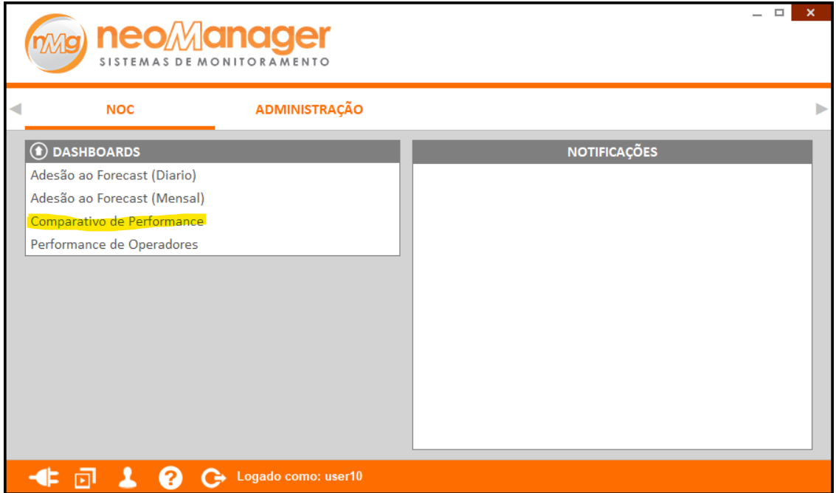
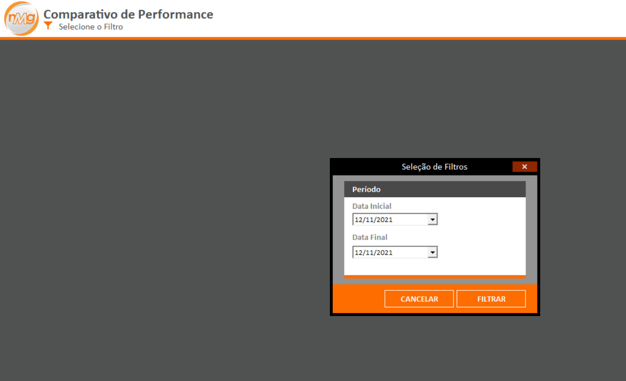

Dashboard manual
2 - Select “Start date”
1 - Select “Performance comparison”
3 - Select “End date”
4 - Select “Filter”

Slide 6
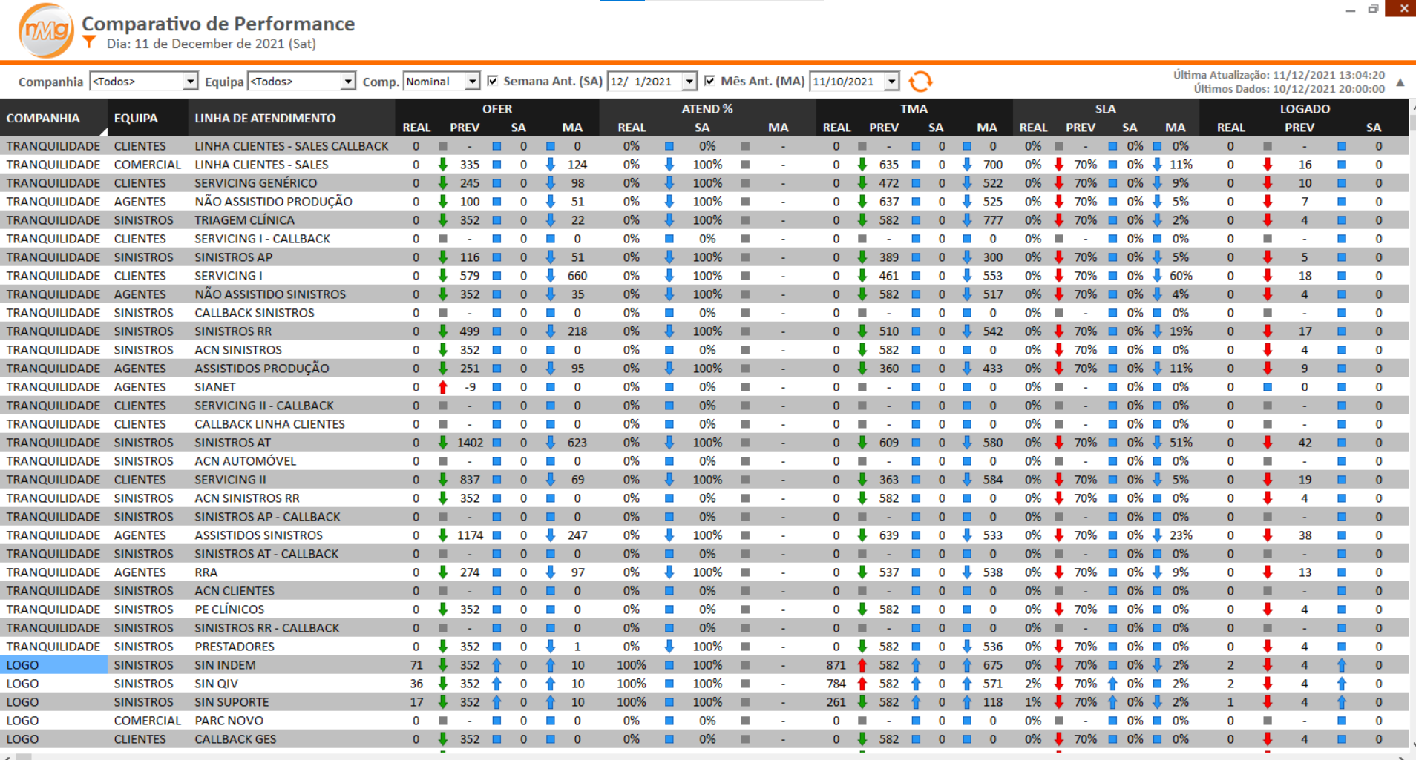
Dashboard manual
Company
Team
Line
Call volume
AHT
Agent hours

Slide 7
Dashboard manual
File extraction

Slide 8
THANKS
datauris.co
linkedin.com/company/datauris/
info@datauris.co

